Slide 1

ASSAM
FIFTH INTERNATIONAL
ASSAM
ISLAMIC UNION CONGRESS

Slide 2

5. INTERNATIONAL ASSAM
ISLAMIC UNION CONGRESS
PRESENTATION PLAN
AIM OF CONGRESS
GEOPOLITICAL VALUE OF ISLAMIC GEOGRAPHY
THE SITUATION OF ISLAMIC GEOGRAPHY
ASSAM congresses IN THE PROCESS OF THE UNION OF ISLAMIC COUNTRIES
FIRST, SECOND , THIRD and FOURTH ASSAM CONGRESS DECLARATIONS
FIFTH INTERNATIONAL ASSAM ISLAMIC UNION CONGRESS FOREIGN POLICY ANALYSIS OFASRICA ISLAMIC STATES UNION
ADNAN TANRIVERDI
18-19 DECEMBER 2021

Slide 3
5. INTERNATIONAL ASSAM
ISLAMIC UNION CONGRESS
AIM OF INTERNATIONAL ASSAM ISLAMIC UNION CONGRESS:
For the Islamic Countries to gather under a common will;
Determining the Necessary Institutions and the appropriate legislation to which these Institutions will be subjected to,
To present a MODEL to the Islamic World and decision makers.

Slide 4
5. INTERNATIONAL ASSAM
ISLAMIC UNION CONGRESS
THE AIM OF OUR CONGRESS
IS THE COMMON FOREIGN POLICY TO BE IMPLEMENTED
FROM THE CONFEDERATION CENTER
AND THE USEFUL FOREIGN POLICY SYSTEMS
TO BE ESTABLISHED
IN THE NINE FEDERAL REGIONS
AND NATIONAL STATES
AFFILIATE TO THE CONFEDERATION

Slide 5
GEOPOLITICAL VALUE OF
ISLAMIC GEOGRAPHY (ASRICA)
GEOPOLITICAL VALUE OF
ISLAMIC GEOGRAPHY (ASRICA CONTINENT)

Slide 6
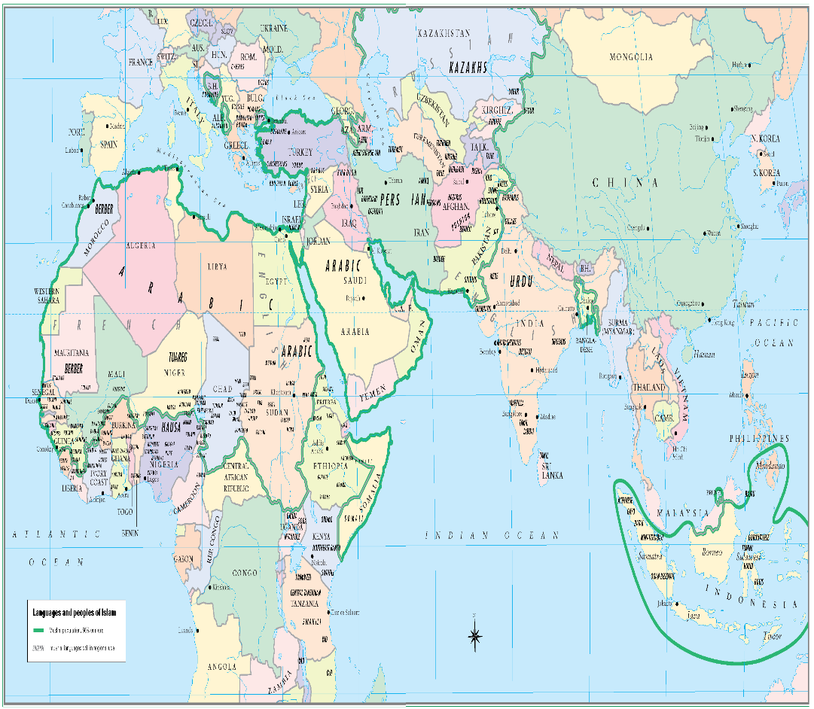
GEOPOLITICAL VALUE OF
ASRICA(ASIA-AFRICA)
ISLAMIC GEOGRAPHY
OF THE 206 STATES THAT ARE MEMBERS OF THE UNITED NATIONS ORGANIZATION, 61 (31% OF THE NUMBER OF MEMBERS) ARE MUSLIM COUNTRIES.
7.911 BILLION (23.1%) OF THE WORLD'S POPULATION OF 7 BILLION ARE PEOPLE OF MUSLIM STATES,
30.9 MILLION KM² (20.6%) OF THE WORLD'S LAND, WHICH IS 150 MILLION KM², IS THE TERRITORY OF 61 ISLAMIC COUNTRIES
THE SPINE OF THE ISLAMIC GEOGRAPHY ASIA/AFRICA
- ASRICA ARE THE CONTINENTS
IN ASIA: 28 -IN AFRICA: 27
IN EUROPE: 04-S. AMERICA:02
TOTAL: 61

Slide 7
GEOPOLITICAL VALUE
OF ISLAMIC GEOGRAPHY
ASRICA
WORLD
ISLAMIC WORLD WHICH OWNS 55.5% OF THE WORLD'S OIL RESERVES, 65% OF ITS PRODUCTION ALSO 64.1% OF NATURAL GAS RESERVES, 40% OF ITS PRODUCTION;
IT HAS THE POTENTIAL TO BE THE SUPERPOWER OF THE FUTURE IN “ASRICA”
BY COMBINING ITS GEOPOLITICAL POSITION, COMMON CIVILIZATION VALUES AND HISTORICAL BACKGROUND WITH ITS OPPORTUNITIES, EFFORTS AND GOALS.
IN EUROPE: 04 -IN AFRICA: 27
IN ASIA: 28-S. AMERICA: 2
TOTAL: 61

Slide 8
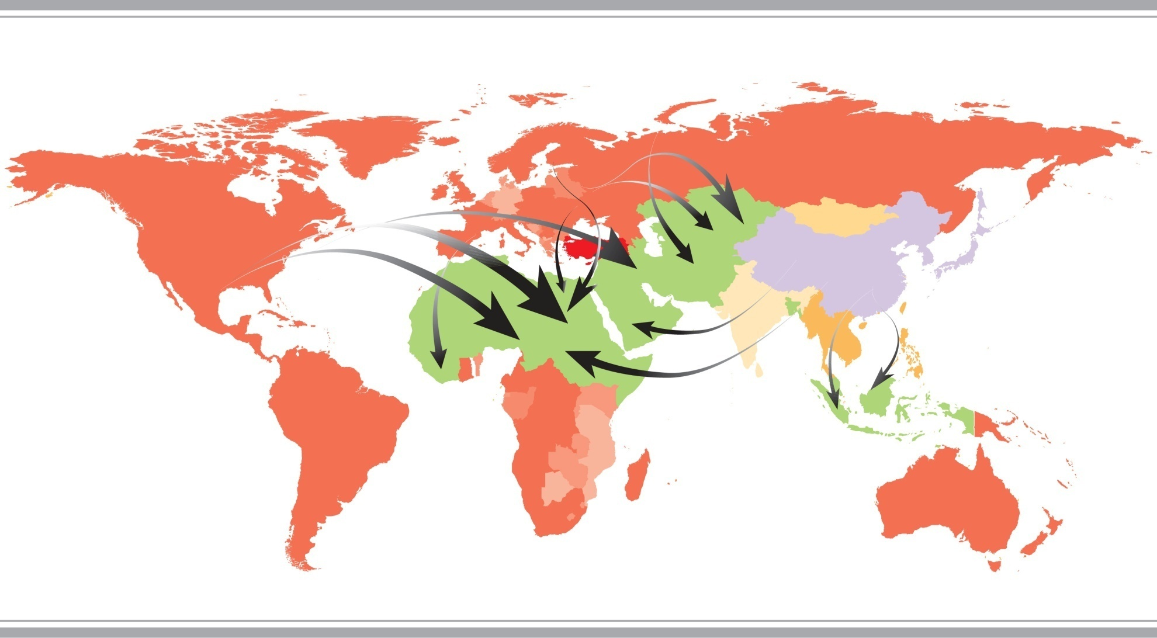

THE SITUATION OF
ISLAMIC GEOGRAPHY
THE SITUATION OF ISLAMIC GEOGRAPHY

Slide 9
THE SITUATION OF
ISLAMIC GEOGRAPHY
TODAY THE MOST INTERVENED IN THEIR LANDS,
MOST OCCUPYING THE UNITED NATIONS,
TERROR AND ANARCHY ARE NOT LACKING IN THEIR LAND,
RESOURCES MANAGED BY FOREIGN POWERS,
HUMAN RIGHTS AND FREEDOMS ARE VIOLATED,

Slide 10
THE SITUATION OF
ISLAMIC GEOGRAPHY
THE INCOME DISTRIBUTION IS CORRUPTED,
POLITICAL, SOCIAL AND ECONOMIC INSTABILITIES PREVAİIL,
DEMANDING AND NEEDING THE HELP AND SUPPORT OF EXTERNAL POWERS TO SOLVE INTERNAL PROBLEMS,
ARE THE ISLAMIC STATES.

Slide 11
ASSAM congresses IN THE PROCESS OF THE UNION OF ISLAMIC COUNTRIES
JUSTICE
INTERNAL AFFAIRS
FOREIGN AFFAIRS
DEFENSE
COMMON WILL
THE STATE'S MAIN FIELDS OF ACTIVITY

Slide 12
ASSAM congresses IN THE PROCESS OF THE UNION OF ISLAMIC COUNTRIES
ASSAM congresses IN THE PROCESS OF THE UNION OF ISLAMIC COUNTRIES

Slide 13
ASSAM congresses IN THE PROCESS OF THE UNION OF ISLAMIC COUNTRIES
AIM
FOR THE ISLAMIC COUNTRIES TO GATHER UNDER A COMMON WILL
INSTITUTIONS THAT ARE REQUIRED AND THE LEGISLATION THAT THESE INSTITUTIONS SHOULD BE,
TO ENSURE THAT IT IS REVEALED AS A MODEL
«International ASSAM Islamic Union Congresses Series» ARE PLANNED

Slide 14
ASSAM congresses IN THE PROCESS OF THE UNION OF ISLAMIC COUNTRIES
SERIES OF INTERNATIONAL ASSAM ISLAMIC UNIONCONGRESSES
Determination of the Legislation on Management Figures And Organs for the Islamic Union (2017),
Determination of Principles And Procedures of Economic Cooperation for the Islamic Union (2018),
Determination of Defense Industry Cooperation Procedures and Principles (2019)
Determination of Common Defense System Procedures and Principles (2020)
Determination of Principles And Procedures of Joint Foreign Policy(2021),
Determination of the Procedures and Principles of the Joint Justice System (2022)
Determination of Common Public Order and Security Procedures and Principles (2023)

Slide 15
ASSAM congresses IN THE PROCESS OF THE UNION OF ISLAMIC COUNTRIES
FIRST INTERNATIONAL ASSAM ISLAMIC UNION CONGRESS
(23- 24 NOVEMBER 2017)
TOPIC:
GOVERNMENT FORMS FROM PAST TO FUTURE

Slide 16
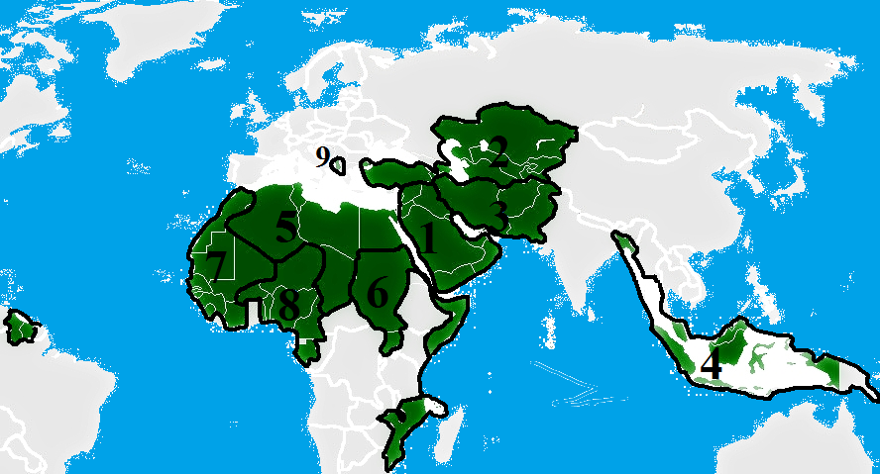
ASSAM congresses IN THE PROCESS OF THE UNION OF ISLAMIC COUNTRIES
ASSAM ISLAMIC COUNTRIES CONFEDERATION
DECLARATION
FOR THE ISLAMIC COUNTRIES TO GATHER UNDER A WILL
AS FIRST STEP:
THE MINISTRIES OF THE ISLAMIC UNION SHOULD BE ESTABLISHED IN THE CABINETS OF ISLAMIC COUNTRIES.
AS SECOND STEP:
THE COUNCIL OF REPRESENTATIVES OF ISLAMIC COUNTRIES MUST BE ESTABLISHED AND
ENSURED TO WORK AS ISLAMIC COUNTRIES CRISIS MANAGEMENT BRANCH.

Slide 17
ASSAM ISLAMIC UNION CONSTITUTION MODEL
ISLAMIC COUNTRIES CONFEDERATION CONSTITUTION
PREAMBLE
…………………………………………………………………………………………
Considering the self-definition and population in the world, the existence of sixty-one Islamic countries is accepted;
Twelve of them, Middle East Islamic Countries (Bahrain, United Arab Emirates, Palestine, Iraq, Qatar, Kuwait, Lebanon, Syria, Saudi Arabia, Oman, Jordan, Yemen),
Eight of them, Middle Asia Islamic Countries (Azerbaijan, Kazakhstan, Kyrgyzstan, Turkish Republic of Northern Cyprus, Uzbekistan, Tajikistan, Turkey, Turkmenistan)
Four of them, Near East Islamic Countries, (Afghanistan, Bangladesh, Iran, Pakistan),
Four of them, South East Asia Islamic Countries (Maldives, Brunei, Indonesia, Malaysia),
Six of them North Africa Islamic Countries, (Algeria, Chad, Morocco, Libya, Egypt, Tunisia),
Six of them, East Afrika (Red Sea Basin) Islamic Countries (Djibouti, Eritrea, Comoros, Mozambique, Somalia, Sudan),
Nine of them, North West Africa – South America Islamic Countries (Gambia, Guinea, Guinea Bissau, Mali, Mauritania, Senegal, Sierra Leone, Guyana-SA, Suriname-SA,)
Eight of them, South West Africa (Ocean Basin) Islamic Countries (Benin, Burkina Faso, Ivory Coast, Gabon, Cameroon, Niger, Nigeria, Togo),
Four of them, European Islamic Countries (Albania, Bosnia and Herzegovina, Kosovo, Macedonia),
If they decide with their free will and accept the conditions of the union, they find it appropriate to include them in the Islamic Union.
FIRST SECTION
General Principles
I. Name and Form of the State;
Article 1- Name of the State; "ASRICA (ASIA-AFRICA) Islamic States Union". ASRICA Islamic States Union is the Confederal Republic.
ASRICA Islamic States Union, the system of separation of powers is applied and governed by a presidential system.
II. Principles and Characteristics of the Confederal Republic;
ARTICLE 2- Comprising with the unity of Europe, Middle Asia, Middle East, Near East, South East Asia, North Africa, North West Africa (Ocean Basin), South West Africa (Ocean Basin), East Africa (Red Sea Basin) Regional Islamic State Federations, accepting to be included in the confederation within the geographical boundaries, with a public of Muslims, ASRICA Islamic States Union is confederation comprising of states, accepting to be managed centrally in the main fields of activities on Justice, Defense, Defense Industry, internal and foreign affairs.

Slide 18
VISION OF ASSAM IN THE PROCESS OF THE ISLAMIC UNION (CONFEDERATION-FEDERATIONS AND AREAS OF ACTIVITY WHICH NATIONAL STATES WILL BE RESPONSIBLE)
www.assam.org.tr
ASRICA
ISLAMIC STATES CONFEDERATION
JUSTICE
REGIONAL ISLAMIC STATES FEDERATIONS
CUSTOMS AND TRADE -TRANSPORT AND SHIPPING
ECONOMY -SCIENCE, INDUSTRY AND TECHNOLOGY
NATIONAL STATES
EDUCATION -FINANCE
FORESTRY AND WATER MANAGEMENT -LABOR AND SOCIAL SECURITY
DEFENSE
INTERNAL AFFAIRS
FOREIGN AFFAIRS
DEVELOPMENT -CULTURE AND TOURISM
SOCIAL POLICIES -ENVIRONMENT AND URBANIZATION
ENERGY AND NATURAL RESOURCES -HEALTH
AGRICULTURE AND LIVESTOCK -YOUTH AND SPORTS
DEFENSE INDUSTRY
18

Slide 19
ASSAM ROAD MAP IN DETERMINING A MODEL FOR THE ISLAMIC UNION
ASSAM'S VISION IN THE PROCESS OF THE UNION OF ISLAMIC COUNTRIES

Slide 20
  ASSAM'S VISION IN THE PROCESS OF THE UNION OF ISLAMIC COUNTRIES
THE FORMATION OF THE ISLAMIC UNION IS A NECESSITY OF THE ERA.
UNDERSTANDING THIS NECESSITY BY THE ISLAMIC
UMMAH IS THE FIRST CONDITION OF THE UNION.

Slide 21
  ASSAM'S VISION IN THE PROCESS OF THE UNION OF ISLAMIC COUNTRIES
FIRST PHASE
REPRESENTING THE COMMON WILL OF 61 ISLAMIC COUNTRIES, WITH ITS AUTHORIZATION, POWER AND STRUCTURE, CONSTITUTIONAL, LAWS AND REGULATIONS, "THE COUNCIL OF REPRESENTATIVES OF ISLAMIC COUNTRIES" IS CONSIDERED AS A PERMANENT;
SUBSEQUENTLY "ISLAMIC COUNTRIES CONFEDERATION" MUST BE ESTABLISHED;

Slide 22
  ASSAM'S VISION IN THE PROCESS OF THE UNION OF ISLAMIC COUNTRIES
SECOND PHASE
STUDIES MUST BE MADE TO DETERMINE THE PROCEDURES AND PRINCIPLES OF JUSTICE, SECURITY (INTERIOR AND FOREIGN) AND JOINT FOREIGN POLICY, WHICH ARE THE FUNDAMENTAL DUTIES OF THE “ISLAMIC COUNTRIES CONFEDERATION”,
“REGIONAL ISLAMIC COUNTRY ASSEMBLIES” WHICH REPRESENT THE COMMON WILL OF ISLAMIC COUNTRIES CLOSE TO ETHNIC AND GEOGRAPHICAL TERMS, SHOULD BE ESTABLISHED AND REGIONAL ISLAMIC COUNTRIES ARE DISTRICT CONFEDERAL COUNTRIES.

Slide 23
ASSAM'S VISION IN THE PROCESS OF THE UNION OF ISLAMIC COUNTRIES
REGIONAL ISLAMIC COUNTRIES CONFEDERATIONS
ARE GROUPED IN 9 DIFFERENT GEOGRAPHIES
MIDDLE EAST [12 COUNTRIES] ,
CENTRAL ASIA [8 COUNTRIES],
NEAR EAST [4 COUNTRIES],
SOUTHEAST ASIA[4 COUNTRIES],
NORTH AFRICA [6 COUNTRIES],
EASTERN AFRICA [6 COUNTRIES],
NORTHWEST AFRICA [9 COUNTRIES],
SOUTH-WEST AFRICA [ 8 COUNTRIES]
EUROPE [4 COUNTRIES]

Slide 24
5. INTERNATIONAL ASSAM ISLAMIC UNION CONGRESS ASRICA ISLAMIC COUNTRIES MAP OF CONFEDERATIONAL REGIONAL FEDERAL STATES

Slide 25
ASSAM'S VISION IN THE PROCESS OF THE UNION OF ISLAMIC COUNTRIES
THIRD PHASE
‘CENTRAL ADMINISTRATIONS OF THE REGIONAL ISLAMIC COUNTRIES, CONFEDERATIONS SHOULD BE STRENGTHENED AND TURN INTO FEDERATIONS;
FEDERATIONS SHOULD BE CONNECTED TO THE “UNION OF ISLAMIC COUNTRIES” AS A CONFEDERATE UNION,

Slide 26
ASSAM'S VISION IN THE
PROCESS OF THE UNION OF ISLAMIC COUNTRIES
ISLAMIC UNION CONFEDERATION
PARLIAMENT
ME
CA
NE
CABINET
SEA
NAf
EAf
NWA
SWAf
EU
PAKISTAN
MALAYSIA
TUNUSIA
SUDAN
SİRUNAM (GA)
TOGO
MACEDONIA
YEMEN
JORDAN
OMAN
SAUDI ARABIA
SYRIA
LEBANON
KUWAIT
QATAR
PALESTINE
UAE
BAHRAIN
TURKEY
TAJIKISTAN
UZBEKISTAN
TRNC
KYRGYZSTAN
KAZAKHISTAN
AZERBAIJAN
IRAN
BANGLADESH
INDONESIA
BRUNEI
EGYPT
LIBYA
MOROCCO
CHAD
AFGHANISTAN
TURKMENISTAN
ALGERIA
SOMALI
MOZAMBIQUE
COMOROS
ERITREA
DJIBOUTI
GUYANA (GA)
SIERRA LEONE
SENEGAL
MAURITANIA
MALI
GUINEA-BISSAU
GUINEA
GAMBIA
NIGERIA
NIGER
CAMEROON
GABON
IVORY COAST
BURKINA FASO
BENIN
KOSOVO
BOSNIA AND HERZEGOVINA
ALBANIA
IRAQ
MALDIVES

Slide 27
ASSAM'S VISION IN THE PROCESS OF THE UNION OF ISLAMIC COUNTRIES
FOURTH PHASE (1)
CENTRAL COMMON WILL AT “CONFEDERATION OF ISLAMIC COUNTRIES”;
COMMON WILLS OF REGIONAL ORGANIZATIONS
SHOULD BE REPRESENTED IN THE "REGIONAL ISLAMIC COUNTRIES FEDERATION PARLIAMENTS",
“EXECUTIVE BRANCHES” UNDER PARLIAMENT SHOULD BE ESTABLISHED.
UNDER THE CONTROL OF THE CENTRAL AND REGIONAL ENFORCEMENT BRANCHES, "JUSTICE COUNCILS" AND
"IMMEDIATE INTERVENTION FORCE" MUST BE INSTALLED TO ENSURE THE IMPLEMENTATION OF THE DECISIONS OF JUSTICE COUNCILS.

Slide 28
ASSAM'S VISION IN THE PROCESS OF THE UNION OF ISLAMIC COUNTRIES
FOURTH PHASE (2)
AN ORGANIZATION SHOULD BE MADE TO ENSURE "PUBLIC ORDER AND INTERIOR SECURITY".
TO PROVIDE EXTERNAL SECURITY, "COMMON DEFENSE INDUSTRY PRODUCTION" AND "DEFENSE ALLIANCE" ORGANIZATION SHOULD BE MADE,
A SUITABLE ORGANIZATION MUST BE ESTABLISHED FOR THE DETERMINATION AND IMPLEMENTATION OF "COMMON FOREIGN POLICIES",
"ECONOMIC COOPERATION" SHOULD BE ESTABLISHED,
A "JURISDICTION SYSTEM" OF "HUMAN RIGHTS" AND "CRIMINAL COURTS" SHOULD BE ESTABLISHED FOR THE CONFEDERATION OF ISLAMIC COUNTRIES AND REGIONAL FEDERATIONS OF ISLAMIC COUNTRIES

Slide 29
5. ASSAM CONGRESS IN THE PROCESS OF UNION OF ISLAMIC COUNTRIES
SECOND INTERNATIONAL ASSAM ISLAMIC UNION CONGRESS
(01- 02 NOVEMBER 2018)
TOPIC:
ISLAMIC ECONOMY AND ECONOMIC SYSTEMS

Slide 30
5. ASSAM CONGRESS IN THE PROCESS OF
THE UNION OF ISLAMIC COUNTRIES
2. ASSAM CONGRESS DECLARATION (1);
AT THE END OF CONGRESS;
For the Islamic countries to reach the level of prosperity above the world standards and gain their economic independence;
USING THE TECHNOLOGY OF THE AGE,
PROMOTING PRODUCTION,
BASED ON GOODS AND SERVICES,
INTEREST-FREE,
PROTECTING LABOR-FUND-CONSUMER,
PROVIDING A FAIR DISTRIBUTION OF INCOME,
NOT AFFECTED BY CHEATING ATTEMPTS OF GLOBAL POWERS,
HAVE THE AUTONOMOUS MONEY CIRCULATION SYSTEM,
It has been declared that the establishment of an Islamic economic system is deemed necessary.

Slide 31
5. ASSAM CONGRESS IN THE PROCESS OF
THE UNION OF ISLAMIC COUNTRIES
2. ASSAM CONGRESS DECLARATION (2)
FOR THIS, AMONG ISLAMIC COUNTRIES;
CUSTOMS UNION
COMMON MARKET
MONETARY UNION,
TRADE ZONES
TRADE COURTS,
FOUNDATIONS AND PARTICIPATION BANKING
CHAMBERS OF COMMERCE MUST BE FORMED.
TO GIVE ZAKAT INSTITUTION AN INSTITUTIONAL IDENTITY UNDER THE CONTROL OF STATES AS A COMMON FUND,
CREATION OF THE ISLAMIC ELECTRONIC DINAR CURRENCY - ASRICA DINAR,

Slide 32
5. ASSAM CONGRESS IN THE PROCESS OF
THE UNION OF ISLAMIC COUNTRIES
2. ASSAM CONGRESS DECLARATION (3)
COMMON MARKET AND COMMON PRODUCTION AND R&D INCENTIVE FUND,
COMMON INVESTMENT FUND AND RESOURCE PLANNING STUDY,
A COMMON CENTER FOR R&D AND INNOVATION
COOPERATIVES-COOPERATION AND ISLAMIC FINANCIAL SYSTEMS
ESTABLISHMENT OF ASRICA, BANK FINANCIAL TRANSFER CENTER (ASRICA-BAFAM),

Slide 33
5. ASSAM CONGRESS IN THE PROCESS OF
THE UNION OF ISLAMIC COUNTRIES
2. ASSAM CONGRESS DECLARATION (4)
IT HAVE BEEN DECLARED THAT TAKING MEASURES TO INCREASE THE FOREIGN TRADE VOLUME,
MAKING PREFERRED TRADE AGREEMENTS,
THE DEVELOPMENT OF CULTURE IN THE COMPOSITION OF LANGUAGE, RELIGION AND HISTORY,
THE FORMATION OF A STRONG POLITICAL WILL

Slide 34
5. INTERNATIONAL ASSAM
ISLAMIC UNION CONGRESS
THIRD
INTERNATIONAL ASSAM ISLAMIC UNION CONGRESS
(19- 20 DECEMBER 2019)
TOPIC:
DEFENSE INDUSTRY COOPERATION PROCEDURES AND PRINCIPLES FOR THE ISLAMIC UNION
«ASRICA JOINT DEFENSE INDUSTRY PRODUCTION»

Slide 35
ASRICA ISLAMIC COUNTRIES CONFEDERATION DEFENSE INDUSTRY ORGANIZATION CHART
(3. ASSAM CONGRESS DECLARATION-1)
ASRICA ISLAMIC COUNTRIES CONFEDERATION PRESIDENT
MINISTRY OF JUSTICE
MINISTRY OF DEFENSE
MINISTRY OF DEFENSE INDUSTRY
PRESIDENCY OF LAND VEHICLES
PRESIDENCY OF NAVAL VEHICLES
PRESIDENCY OF AVIATION SYSTEMS
PRESIDENCY OF R&D
AIR DEFENSE PRESIDENCY AIR DEFENSE AND WEAPON SYSTEMS
PRESIDENCY OF STANDARDIZATION AND METROLOGY
PRESIDENCY OF ELECTRONIC WARFARE SYSTEMS
PRESIDENCY OF CYBER SECURITY
MINISTRY OF INTERNAL AFFAIRS
MINISTRY OF FOREIGN AFFAIRS
PRESIDENCY OF SPACE SYSTEMS

Slide 36
5. INTERNATIONAL ASSAM
ISLAMIC UNION CONGRESS
(3. ASSAM CONGRESS DECLARATION-2)
RELATED TO THE DEFENSE INDUSTRY;
  INVENTORY OF PRODUCTS,
  DETERMINATION OF NEEDS,
  STORAGE AND DISTRIBUTION,
  RENOVATION,
  MODERNIZATION,
  SCRAP - DEBRIS - RUN-DOWN MATERIAL SEPERATION,
  RECOVERY AND RECYCLING
The activities are to be conducted under Ministry of Defense Industry;

Slide 37
5. INTERNATIONAL ASSAM
ISLAMIC UNION CONGRESS
(3. ASSAM CONGRESS DECLARATION-3)
The establishment of "DEFENSE INDUSTRY PRESIDENCES" in Nine Regional Islamic Countries Federations, affiliated with the MINISTRY OF DEFENSE INDUSTRY, and "DEFENSE INDUSTRY PRESIDENCIES" within the National States under these presidencies,
Regarding the production of Land, Naval, Air, Air Defense, Space, Cyber and Electronic Defense Industry products;
  MAIN CONTRACTORS to "Regional Federations of Islamic States";
  The division of SUB-CONTRACTORS to National States,

Slide 38
5. INTERNATIONAL ASSAM
ISLAMIC UNION CONGRESS
(3. ASSAM CONGRESS DECLARATION-4)
In the REGIONS OF Defense Industry Production MAIN AND SUB-CONTRACTORS, regarding the Defense Industry Product it produces;
  R&D,
  STANDARDIZATION,
  CERTIFICATION,
  ACCREDITATION,
  CODIFICATION and
  MAINTENANCE
Formation of centers,

Slide 39
5. INTERNATIONAL ASSAM
ISLAMIC UNION CONGRESS
(3. ASSAM CONGRESS DECLARATION-5)
Related to the Defense Industry products allocated to the Regional Islamic Federations and National States, which are assigned as Defense Industry Main and Subcontractors
VOCATIONAL SCHOOLS,
VOCATIONAL HIGH-SCHOOLS AND
MAIN SCIENCE DEPARTMENTS WILL BE ESTABLISHED IN UNIVERSITIES,
DECLARED AND PREPARED DECLARATIONS UNDER ASSAM WEB SITE are available to the Public.

Slide 40
5. INTERNATIONAL ASSAM
ISLAMIC UNION CONGRESS
FOURTH INTERNATIONAL ASSAM ISLAMIC UNION CONGRESS
(12 DECEMBER 2020)
TOPIC
PROCEDURES AND PRINCIPLES OF THE COMMON DEFENSE SYSTEM FOR THE ISLAMIC UNION
ASRICA CONFEDERATION DEFENSE SYSTEM

Slide 41
5. INTERNATIONAL ASSAM
ISLAMIC UNION CONGRESS
IN THE DECLARATION PUBLISHED AT THE END OF THE CONGRESS
It is essential that the DEFENSE OF COUNTRIES ARE CONDUCTED FROM THE CENTER;
MINISTRY OF DEFENSE constitutes ONE OF THE FIVE AREAS OF ACTIVITY to be carried out centrally by the Confederation.

Slide 42

ASRICA
CONFEDERATION OF ISLAMIC COUNTRIES
DEFENSE ORGANIZATION
ASRICA
ISLAMIC COUNTRIES CONFEDERATION
PRESIDENT
JUSTICE
FOREIGN AFFAIRS
INTERNAL AFFAIRS
FOREIGN AFFAIRS
DEFENSE
FOREIGN AFFAIRS
TURKISH GENERAL STAFF
LAND FORCES COMMAND
AIR FORCES COMMAND
AIR DEFENSE AND MISSILE COMMAND
CYBER AND ELECTRONIC SECURITY COMMAND
DEFENSE
DEFENSE INDUSTRY
FOREIGN AFFAIRS
FOREIGN AFFAIRS
NAVAL FORCES COMMAND
CONFEDERATION
SECURITY COUNCIL
NINE JOINT OPERATION COMMAND

Slide 43
5. INTERNATIONAL ASSAM
ISLAMIC UNION CONGRESS
CONFEDERATE REPUBLIC SECURITY COUNCIL CONSISTS OF;
UNDER THE PRESIDENCY OF CONFEDERATE REPUBLIC,
VICE PRESIDENTS OF CONFEDERATE REPUBLIC,
PRESIDENTS OF REGIONAL FEDERAL REPUBLIC (9),
JUSTICE,
NATIONAL DEFENSE,
INTERIOR AFFAIRS,
MINISTERS OF FOREIGN AFFAIRS,
CHIEF OF GENERAL STAFF,
LAND, NAVAL, AIR AND JOINT FORCE (9) COMMANDANTS

Slide 44
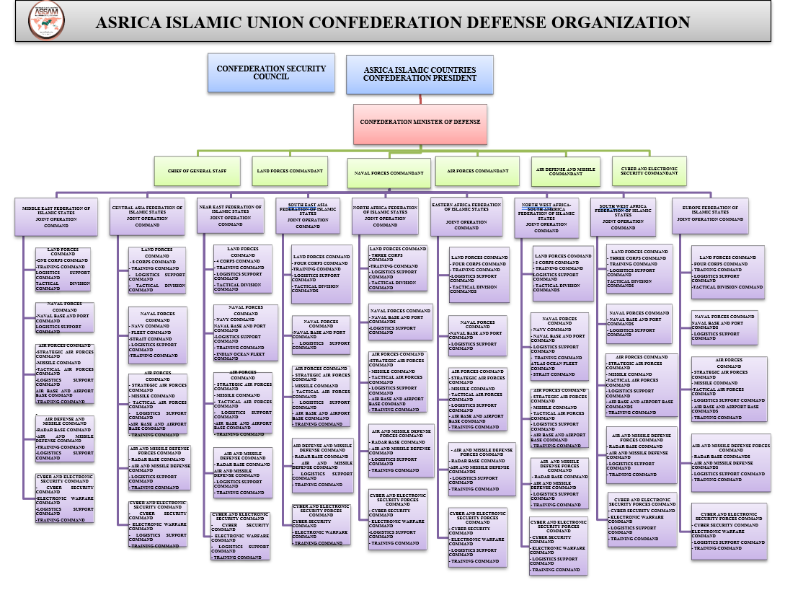
5. INTERNATIONAL ASSAM ISLAMIC UNION CONGRESS

Slide 45

FORCES, INSTITUTIONS AND UNITS AFFILIATED TO THE JOINT OPERATION COMMAND IN FEDERAL ZONES
FORCES | INSTITUTIONS | I. REGION | II. REGION | III. REGION | IV. REGION | V. REGION | VI. REGION | VII. REGION | VIII REGION | IX. REGION | TOTAL
LFC | CORPS COMMAND | 1 | 8 | 4 | 4 | 3 | 4 | 5 | 3 | 4 | 36
 | TRAINING COMMAND | 1 | 1 | 1 | 1 | 1 | 1 | 1 | 1 | 1 | 9
 | LOGISTICS SUPPORT COMMAND | 1 | 1 | 1 | 1 | 1 | 1 | 1 | 1 | 1 | 9
 | TACTICAL DIVISION COMMAND | 1 | 1 | 1 | 1 | 1 | 1 | 1 | 1 | 1 | 9
NAVAL FORCES COMMAND | NAVY COMMAND | - | 1 | 1 | - | - | - | 1 | - | - | 3
 | FLEET COMMAND | - | 2 | 1 | 1 | - | - | 1 | - | - | 4
 | NAVAL BASE AND PORT COMMAND | 1 | 1 | 1 | 1 | 1 | 1 | 1 | 1 | 1 | 9
 | STRAIT COMMAND | - | 1 | - | - | - | - | 1 | - | - | 2
 | LOGISTICS SUPPORT COMMAND | 1 | 1 | 1 | 1 | 1 | 1 | 1 | 1 | 1 | 9
 | NAVAL TRAINING COMMAND | - | 1 | 1 | 1 | - | - | 1 | - | - | 4
AIR FORCES FORCES | STRATEGIC AIR FORCES COMMAND | 1 | 1 | 1 | 1 | 1 | 1 | 1 | 1 | 1 | 9
 | MISSILE COMMAND | 1 | 1 | 1 | 1 | 1 | 1 | 1 | 1 | 1 | 9
 | TACTICAL AIR FORCES COMMAND | 1 | 1 | 1 | 1 | 1 | 1 | 1 | 1 | 1 | 9
 | LOGISTICS SUPPORT COMMAND | 1 | 1 | 1 | 1 | 1 | 1 | 1 | 1 | 1 | 9
 | AIR BASE AND AIRPORT BASE COMMAND | 1 | 1 | 1 | 1 | 1 | 1 | 1 | 1 | 1 | 9
 | TRAINING COMMAND | 1 | 1 | 1 | 1 | 1 | 1 | 1 | 1 | 1 | 9
AIR DEFENSE FORCES | RADAR BASE COMMANDS | 1 | 1 | 1 | 1 | 1 | 1 | 1 | 1 | 1 | 9
 | AIR AND MISSILE DEFENSE COMMANDS | 1 | 1 | 1 | 1 | 1 | 1 | 1 | 1 | 1 | 9
 | LOGISTICS SUPPORT COMMAND | 1 | 1 | 1 | 1 | 1 | 1 | 1 | 1 | 1 | 9
 | TRAINING COMMAND | 1 | 1 | 1 | 1 | 1 | 1 | 1 | 1 | 1 | 9
CYBER ELECTRONIC SECURITY FORCES COMMAND | CYBER SECURITY COMMAND | 1 | 1 | 1 | 1 | 1 | 1 | 1 | 1 | 1 | 9
 | ELECTRONIC WARFARE COMMAND | 1 | 1 | 1 | 1 | 1 | 1 | 1 | 1 | 1 | 9
 | LOGISTICS SUPPORT COMMAND | 1 | 1 | 1 | 1 | 1 | 1 | 1 | 1 | 1 | 9
 | TRAINING COMMAND | 1 | 1 | 1 | 1 | 1 | 1 | 1 | 1 | 1 | 9

Slide 46
5. INTERNATIONAL ASSAM
ISLAMIC UNION CONGRESS
JOINT OPERATION COMMAND
Given to the Operational Control of JOINT OPERATION COMMAND and Deployed at the Centers of National States:
AS COMBAT AND COMBAT SUPPORT UNIT;
It is envisaged that 36 Corps Command in Land Forces,
In Naval Forces: Three Navy, Three Fleet and Three Straits Commands,
In Air Forces; 9 Strategic, 9 Tactical Air Forces Commands and 9 Missile Command,
In Air Defense Command; 9 Radar Base Command and 9 Air and Missile Defense Command,
In Cyber and Electronic Security Command; 9 Cyber Security and 9 Electronic Warfare Command,

Slide 47
5. INTERNATIONAL ASSAM
ISLAMIC UNION CONGRESS
Given to the Operational Control of JOINT OPERATION COMMANDS and Deployed at the Centers of National States:
As Also Combat Service Support Unit;
9 Logistics Support Command for each of the Land, Navy, Air, Air and Missile Defense and Cyber and Electronic Force Commands,
Nine Training Commands for each of the Force Commands other than the Naval Forces, and four Training Commands for the Naval Forces, at the Naval Forces Command,
It is envisaged to establish nine Base and Port Commands and Nine Base and Air Base Commands under the Air Force Command.

Slide 48
5. INTERNATIONAL ASSAM
ISLAMIC UNION CONGRESS
Given to the Operational Control of JOINT OPERATION COMMANDS and Deployed at the Centers of National States:
FORCES, INSTITUTIONS AND UNITS AFFILIATED TO THE JOINT OPERATION COMMAND IN FEDERAL ZONES
The Combat, Combat Support, Combat Service Support Commands and their affiliates in each Regional Federation's Geography should be assigned to the Operational Control of the Joint Operation Commands of the Regional Islamic Federations

Slide 49
5. INTERNATIONAL ASSAM
ISLAMIC UNION CONGRESS
PROCEDURES AND PRINCIPLES OF THE COMMON FOREIGN POLICY FOR THE ISLAMIC UNION
It will be examined under the title of
« FOREIGN POLICY ANALYSIS OF THE ASRICA CONFEDERATION»

Slide 50
5. INTERNATIONAL ASSAM
ISLAMIC UNION CONGRESS
AIM OF CONGRESS IS Analyzing the relations of the CONFEDERATION
with its Neighbors and Global Powers,
its rights and interests in Neighboring Geographies,
Inland Seas and Oceans, the Diplomatic Network it will Form in the States around the World,
the Foreign Representation System in its Center, Federal Regions and National States,
AND FINALLY IS TO DETERMINE THE PROCEDURES AND PRINCIPLES OF THE PLANNED FOREIGN POLICY OF CONFEDARATION.

Slide 51
5. INTERNATIONAL ASSAM
ISLAMIC UNION CONGRESS
SUBTITLES OF FIFTH CONGRESS (1)
IN OUR CONGRESS;
ASSESSMENT OF GEOPOLITICAL STATUS OF ASRICA ISLAMIC COUNTRIES
EFFECTS OF GLOBALIZATION AND ITS EFFECTS ON SOCIETIES
OBJECTIVES OF GLOBAL POWERS ON ISLAMIC COUNTRIES AND THEIR FOREIGN POLICY OPTIONS
  ISLAMOPHOBIA
  EAST TURKESTAN ISSUE AND THE POLICIES TO FOLLOW
  KASHMIR ISSUE AND THE POLICIES TO FOLLOW
  AFGHANISTAN ISSUE AND THE POLICIES TO FOLLOW
  THE EFFECTS OF THE CHINA-SILK ROAD PROJECT ON THE ISLAMIC WORLD
  MIDDLE-EAST ISSUE AND THE POLICIES TO FOLLOW
  LIBYA ISSUE AND THE POLICIES TO FOLLOW
  TRNC AND EASTERN MEDITERRANEAN ISSUE AND THE POLICIES TO FOLLOW
  POLICIES OF GLOBAL POWERS ON AFRICAN MUSLIM COUNTRIES
  GEOGRAPHY OF TURKEY AND ITS EFFECTS ON ASRICA

Slide 52
5. INTERNATIONAL ASSAM
ISLAMIC UNION CONGRESS
SUBTITLES OF FIFTH CONGRESS (2)
INSTITUTIONS THAT CAN SOLVE THE INTERNATIONAL PROBLEMS OF ISLAMIC COUNTRIES, AND THEIR EFFICIENCIES AND COMPETENCIES
FORMATION PRINCIPLES AND PROCEDURES OF INSTITUTIONS NEEDED TO BE APPLIED IN THE SOLUTION OF COMMON AND INDIVIDUAL PROBLEMS OF ISLAMIC COUNTRIES
DESIGNED FOREIGN POLICY PRINCIPLES AND PROCEDURES OF ASRICA ISLAMIC COUNTRIES CONFEDERATION
TO REVEAL AN IDEAL MODEL FOR THE ASRICA CONFEDERATION OF ISLAMIC COUNTRIES AT THE END OF THE CONGRESS BY CONDUCTING EXAMINATIONS AND EVALUATIONS ON THE SUBJECTS.

Slide 53
5. INTERNATIONAL ASSAM
ISLAMIC UNION CONGRESS
OUR CONGRESS;
WITH TELECONFERENCE METHOD
IT WILL BE TRANSLATED SIMULTANEOUSLY
IN TURKISH, ENGLISH AND ARABIC.
ABSTRACT OF PRESENTATIONS AND PRESENTATIONS
  WILL BE PUBLISHED IN ASSAM WEBSITE
  and (ASSAM-UHAD)
CONGRESS RESULT REPORTS:
  WILL BE PUBLISHED IN ASSAM WEBSITE AND
  WILL BE SENT TO DECISION MAKING MECHANISMS,
  INVITEES AND PARTICIPANTS.

Slide 54
5. INTERNATIONAL ASSAM ISLAMIC UNION CONGRESS
5. AFTER INTERNATIONAL ASSAM ISLAMIC UNION CONGRESS
EVERY FOLLOWING YEAR;
  JOINT JUSTICE SYSTEM(2022),
  JOINT PUBLIC ORDER AND SECURITY(2023),
WE AIM TO REVEAL A MODEL THAT WILL GATHER ISLAMIC COUNTRIES UNDER ONE WILL by the end of 2023 by presenting the subjects sequentially.

Slide 55
5. INTERNATIONAL ASSAM CONGRESS-2021
ASSAM
Association of justice defenders strategic studies center
Marmara Mahallesi Hürriyet Bulvarı No: 110/H Beylikdüzü/ İSTANBUL 34524 TÜRKİYE
0212 855 19 75
info@assam.org.tr
www.assam.org.tr

